Slide 1
Professional Presentation
Guidelines
Name (presenter)
Capella University
School of Nursing and Health Sciences
Course
Date
Notes:
Please be sure that your title slide includes a title, your name, Capella University, the course, and the date.
The title should reflect your topic and not u09a01, etcetera. There is no running head, but the other information from the Capella University School of Nursing and Health Sciences APA template.

Slide 2
Microsoft PowerPoint
Disperses information.
Can add visuals such as images or graphs.
Can add film clips, sound, and animation.
Notes:
Developing a presentation is an important skill needed for your Capella program and will enhance your communication and presentation skills in your daily practice settings. While some nursing, health sciences, and public health roles have more opportunities than others. Professional presentations disperse information and allow you to share visual representations with your audience, whether you are presenting content in a course, in a meeting, or as part of an educational opportunity.
There are some rules for presenters that will help you create powerful and professional presentations.
At Capella, it is also important that you develop the skill of adding audio to your presentation.
The guidelines presented here are designed to help you set up the slide deck.
You can also add links to film clips, animations, and graphics to the presentation.
Remember that references should be included for your sources and should follow APA guidelines. Your reference list will appear at the end of the presentation.
On the slide itself, you will provide a citation with authors and year of publication, just like in an APA paper. It can be in a smaller font.
Make certain your references are scholarly, less than 5 years old, and peer-reviewed.
You do not have to provide the citation on the slide and in the speaker notes; one or the other is usually sufficient.
Here is a library guide for creating PowerPoint presentations: https://capellauniversity.libguides.com/powerpoint

Slide 3
Getting Started
Create a topic outline based on grading rubric.
  Do not use whole sentences as headings.
Create a slide or two as needed.
  Address each criterion in the rubric.
Select a slide design.
  Consider contrast of background to text.
Notes:
It is always a good practice when creating a presentation for an assignment that you read over and understand the directions for your presentation as well as the grading criteria.
Do not create a title that is a complete sentence or that goes to a second line as that gets to be too much and is not visually appealing.
The grading rubric serves as a good guide for your slides. Try to create 1–2 slides for each criterion of the rubric.
The title and the bullet should not exceed the 5–7 rule or be on a second line. We will explore that idea on another slide.
Be sure you look at the time frame for the presentation and the number of slides you should include in the presentation. When using the grading rubric as an outline—look at the topics for ideas—but do not have long sentences as your titles or bullets!
The fun part is picking a slide design or background.
Now, at Capella, you will be presenting to an audience that is viewing your presentation from a computer screen, but you do need to think about what your slides would look like if you were presenting in a face to face environment—whether it is a classroom, a boardroom, or a stage.
Be sure to pick a background that is visually pleasing with a contrasting color for the text; you do not want your words disappearing into the background.
There are a variety of places to get your backgrounds.
Your PowerPoint or presentation software will have some choices.
Some designs are available commercially for free or for a minimal cost (avoid paying for them, but beware of copyright laws).
There are subscription services that allow you to use their backgrounds and graphics, but this can be expensive and not worth it unless you are doing a lot of presentations.
If you have an artistic flair, you can even create your own background. Sometimes the background can represent your theme.
Be careful not to have a background that is too complex as it can distract from your message!

Slide 4
General Guidelines
5–7 rule.
  Limit lines to 5–7 per slide.
  Limit words to 5–7 per line.
Font.
  Arial or Times New Roman.
  26 points or larger.
Notes:
The idea of “white space” on a slide keeps your presentation from becoming too busy.
Often learners have the idea that they have to include every detail on the slide and will fill every inch of the slide with information. While it is important to limit the number of slides to the assignment requirements for the presentation, remember the audience will be looking at the slide while you are speaking. In this case, less is more.
You want to follow the 5–7 rule to keep the slide from getting too crowded. Another key is if you limit your bullets to short and powerful points (as opposed to full sentences); you will not be reading your slides to the audience.
For those of you getting used to doing presentations, it is hard to remember to keep bullets short and to the point.
While the short bullets are on the slides, you still need that detail (especially if you end up having technical difficulties and your instructor has to see what you meant to say). So, it is important to put the details in the speaker’s notes as you are seeing here in this presentation.
When submitting presentations for class, remember that you need a transcript (if you fill out the speakers’ notes correctly, that can be all you need). Some people prefer a separate document for a transcript but this is not usually required.
You can create a free-standing document with a voice recognition program for a transcript. If you use Kaltura for your recordings, the system will provide close captioned information on your presentation after 24 hours. Be sure to check with your faculty member if there is a preference for how to provide the transcript.

Slide 5
Adding the Extras
Smart Art
More visually pleasing than a table
A good way
You can add text in or out of the grid
To present points with flair
Don’t overdo it!
Notes:
While you want to be entertaining, resist the urge to add too much to your slides.
It is fun to add those slide transitions that fly your words in but stick to only one or two of those per presentation. You would want to use the same format for each slide transition.
Graphics with animation are entertaining but can be distracting to the audience.
Tables and charts can provide helpful information, but the font can distract your audience if is too small.

Slide 6
Transitions
No more than one or two animated transitions.
Several choices available.
Advancing the slides.
  On mouse click (easiest).
  On a timer.
Transitions.
  By slide or bullet point.
Notes:
People get excited about new technology and will sometimes use a different transition for each slide. That can be very distracting for the audience.
Some of the choices include:
Cut, Fade, Push, Wipe, Split, Reveal, Random Bards, Shapes, Uncover. They can fly in from the left, right, top, or bottom.
Again—do not get carried away with a different transition for each slide. Pick one and stick with it!
You would want to use the same format for each slide transition. Some people like to have the entire slide appear with the transition, but you can also have one line at a time appear as you discuss topics. However, this too can be distracting if you do not practice it.
You can advance slides manually by using your mouse or you can set up a timer.
The use of timed slides can be very impressive, but it takes practice to make sure you do not have too long or short a time frame per slide.
Keep in mind that if you are stopped for questions during your presentation the slide timing can be affected.

Slide 7
Adding the Extras 1
Word Art
Fancy fonts for titles – best for flyers or posters
Notes:
While you want to be entertaining, resist the urge to add too much to your slides.
Too many different fonts, too many color changes, or too many words crowded onto a slide can actually lessen the power of your message.
Complete sentences or too many lines make the slides harder to read for the audience.
Be consistent in your use of periods—use them or do not. Most bullets should be phrases and not complete sentences; so obey the rules of grammar!

Slide 8


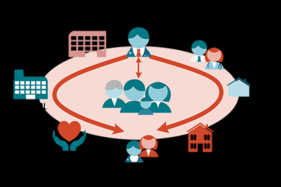
Adding the Extras 2
Graphics
Blurry and copyrighted – don’t use
Notes:
Remember it is nice to tie a graphic into your topic or relate it to your slide.
Graphics can add a cue for visual learners, but again too many can make your slide clumsy and distracting to the audience.
You can use pictures or clip art. If you use graphics from the Internet, Microsoft Office, or a subscription service, beware of violating copyright laws!
You have to get permission to use copyrighted pictures and you need to provide your references on the slide!
Be sure that any graphics you use are not blurry. Sometimes that means rather than copying them you will “save as” and then insert them into the slide.
For citing an image or graphic go to: http://libraryfaqs.cu-portland.edu/faq/103029
For navigating healthcare this is the link: https://www.google.com/imgres?imgurl=http%3A%2F%2Fnebula.wsimg.com%2F027196d4178e32ebd361357c56eaf7e4%3FAccessKeyId%3DFD47805A24032F4E4143%26disposition%3D0%26alloworigin%3D1&imgrefurl=http%3A%2F%2Fwww.abthealth.com%2Fnavigating-healthcare.html&docid=wVBXYB7Qvn03nM&tbnid=CsurC2rEyx0BGM%3A&vet=1&w=723&h=482&bih=522&biw=1063&ved=0ahUKEwj4p93jt9zUAhXo44MKHb3lA1oQMwgiKAEwAQ&iact=c&ictx=1
This link is too much for a slide, so use this one instead www.abthealth.com/navigatinghealthcare.html
The information found on this website is often sufficient.

Slide 9
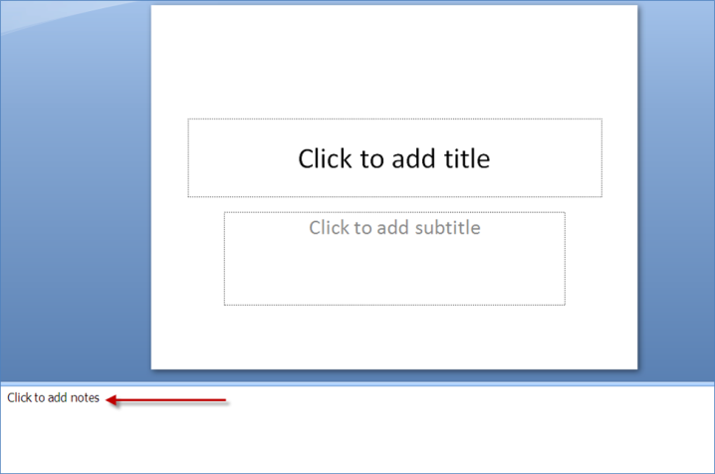
Add Speaker Notes
Notes:
As you have seen, I have used speaker notes to provide detail and a transcript as needed.
Your faculty will be looking for your speaker notes when grading assignments, especially if your presentation has technical difficulties and if you are inaudible! If there is no audio in the presentation, speakers’ notes are vital to getting your ideas across.

Slide 10
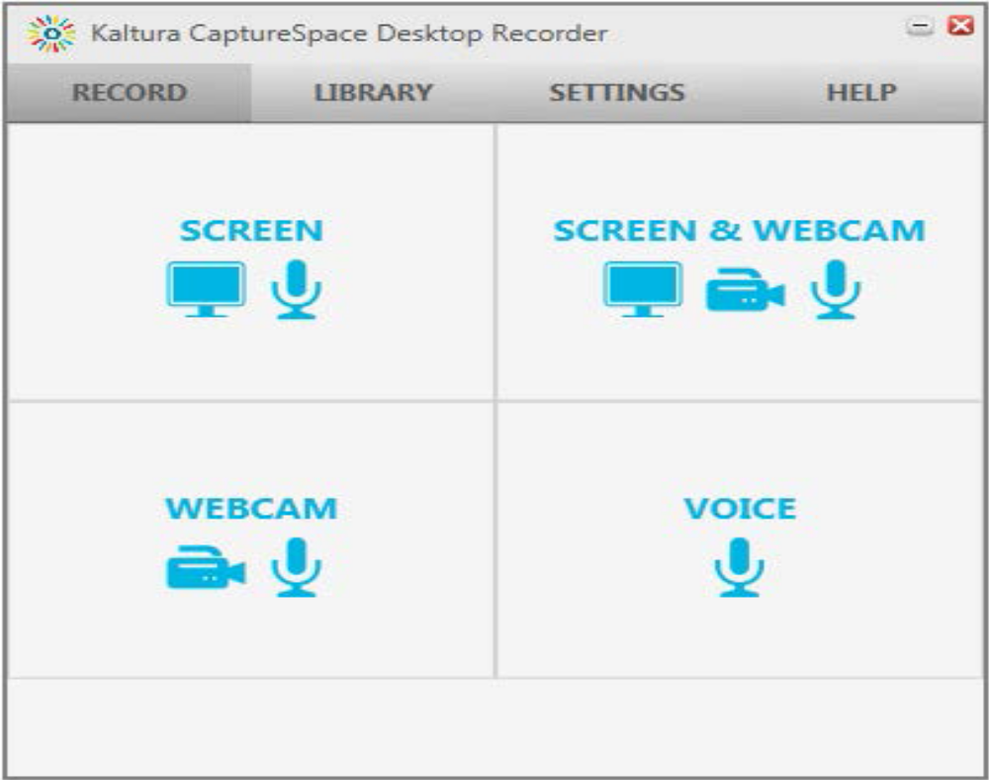
Recording the Presentation?
Some courses require audio presentations
  Kaltura
Notes:
If you have to record your presentation rather than just submit the slide deck, there are a variety of options available for you. While there are more options than Kaltura and Adobe, these are here because they are the ones available through Capella and supported by IT. While you are free to use other programs, your faculty and IT may not be able to help you if there is a problem. Voice over PowerPoint is another option that is popular, but there are several others.
Kaltura is one of the easiest to use. It is available in all courserooms. You have the option of showing the screen (minimal for presentations if you are shy), showing the screen and using the webcam (for presentations is preferred), showing yourself on webcam (like a video blog), showing the screen (just the slides), or just using audio (no slides). The nice part of Kaltura is that captions will appear after 24 hours, eliminating the need for a separate transcript. However, you will still need to include speaker notes.
This link https://assets.capella.edu/campus/support-teams/technical/Using_Kaltura.pdf will take you to the tutorial that will cover the following:
Navigate to Kaltura CaptureSpace Lite.
Download the Kaltura CaptureSpace Lite desktop recorder application. Install the Kaltura CaptureSpace Lite desktop recorder application to Windows.
Install the Kaltura CaptureSpace Lite desktop recorder application to Mac.
Adjust the Kaltura settings for your microphone and webcam.
Record a Kaltura video.
Edit a recording.
Embed a recording into the courseroom.
Attach existing Kaltura media in Other Activities.
Upload Non-Kaltura media to the courseroom.
The first time you try to access Kaltura in the courseroom, you will need to download the Kaltura CaptureSpace Lite desktop recorder application to your computer device. Even if you have used Kaltura in the past, you will still need to download the desktop recorder after the Kaltura media tool has been upgraded in the courseroom, on 3/22/2017.
Download the Kaltura CaptureSpace Lite desktop recorder application to your computer in order to record and be sure you have a webcam and headset ready.
Go to any assignment and select Write Submission on the text editor under Upload Assignment page; select Mashups then Kaltura Media
On the My Media click Add New and then click CaptureSpace Lite.
On the Kaltura CaptureSpace Lite desktop recorder page choose either Windows or Mac to download the installer.
Save the file and run it to install.
After the initial download, you will have Kaltura on your desktop or application folder and then you can access it from there.
Here are some helpful media links for Kaltura:
http://media.capella.edu/NonCourseMedia/KalturaBasics/KalturaBasics.asp
https://assets.capella.edu/campus/support-teams/technical/Using_Kaltura.pdf

Slide 11
Adobe Connect
Adobe Connect.
  Host and attend online meetings.
  Create a meeting room.
  Attend a meeting.
  Record a presentation.
For instructions and more information go to the Using Adobe Connect page on Campus.
While there are other products available, these are the two available to you as a Capella learner.
Notes:
Adobe Connect is still available, but it can be a bit more complicated. The tutorials and instructions can be found here: https://campus.capella.edu/web/tutorials/using-adobe-connect

Slide 12
Finishing the Presentation
Proofread!!!!
Then proofread again.
Run spell check.
Read it out loud.
Have someone read it to you.
Notes:
The final points to remember are to polish up your final work.
You need to correct any spelling or punctuation errors. Remember that missing or repeated words can be distracting to the audience.
Run spell check and have someone else proofread your slides to catch potential typos. While it seems one or two typos can get missed, you would want to avoid them as much as possible to appear professional!

Slide 13
Helpful Tips
Be concise.
Know your audience.
Use animations and graphics wisely.
Add background sound or music.
Make use of color, design, and style.
Link to video clips or websites from the Internet.
Structure your presentation.
Notes:
Steps:
Be as concise as possible.
Know your audience.
Use animations and graphics wisely.
Add background sound or music to keep the presentation interesting.
Make use of color, design, and style.
Link to video clips or websites from the Internet.
Structure your presentation.
Practice your presentation.
More items:
How to Make PowerPoint Presentations More Interesting (with sample)
www.wikihow.com/Make-PowerPoint-Presentations-More-Interesting

Slide 14

Finishing Up!
Summary.
Intro.
  Tell them what you want to tell them.
Body.
  Tell them.
Conclusion or Summary.
  Tell them what you told them.
Practice.
Any Questions?
Notes:
It is always a good practice to include a final wrap up a slide. Ask if there are any questions or provide a summary.
Some presentations benefit from having both, while others only require the use of one or the other.
There are a variety of question clip art samples that are either static or animated and are free of charge or available from Microsoft Office.
The next slide will show how to do a hanging indent for your references. Thanks!

Slide 15
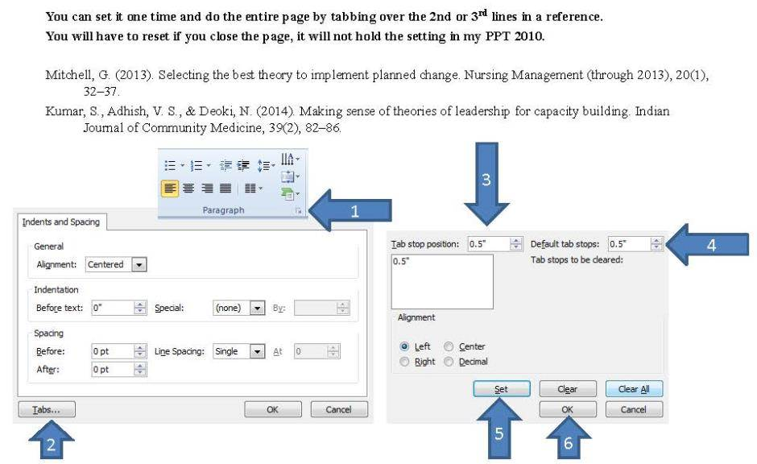
APA Hanging Indent on PPT
Notes:
Steps:
Be as concise as possible.
Know your audience.
Use animations and graphics wisely.
Add background sound or music to keep the presentation interesting.
Make use of color, design, and style.
Link to video clips or websites from the Internet.
Structure your presentation.
Practice your presentation.
More Items:
How to Make PowerPoint Presentations More Interesting (with sample)
www.wikihow.com/Make-PowerPoint-Presentations-More-Interesting

Slide 16
Additional Resources
Face-to-Face Presentations.
Microsoft Office Software.
Designing an Effective PowerPoint Presentation: Quick Guide.
Creating Effective PowerPoint Presentations (YouTube videos).
Notes:
There are guides and tips from Capella that you can access on Campus at: Face-to-Face Presentations.
These others are helpful places to search for tips.

Slide 17

Any Questions?
Notes:
Thank you for viewing this presentation! We hope it will help you prepare professional and scholarly presentations!

